Slide 1

P-153- Hourly Energy Consumption Forecast
TEAM 4
Mr. Dharmendra Vinod Makwana
Mr. Rajesh Mukund Bharati
Mr. Mohd Yasir
Ms. Sonali Sahu
Mr. Akshay Arvind Ukey
Mr. Tejas Ratti
Mr. Sonu Kumar
Mentor – Neha Gupta

Slide 2
BUSINESS OBJECTIVE
PJM Interconnection LLC (PJM) is a regional transmission organization (RTO) in the United States. It is part of the Eastern Interconnection grid operating an electric transmission system serving all or parts of Delaware, Illinois, Indiana, Kentucky, Maryland, Michigan, New Jersey, North Carolina, Ohio, Pennsylvania, Tennessee, Virginia, West Virginia, and the District of Columbia.
The hourly power consumption data comes from PJM's website and are in megawatts (MW).
The regions have changed over the years so data may only appear for certain dates per region.
Throughout this project, we will be building a model to forecast monthly electricity consumption from PJM'S website. This model will be based on time series data.

Slide 3
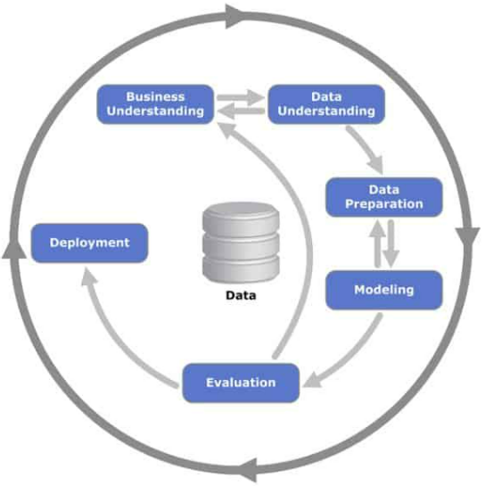
Project Architecture / Project Flow

Slide 4
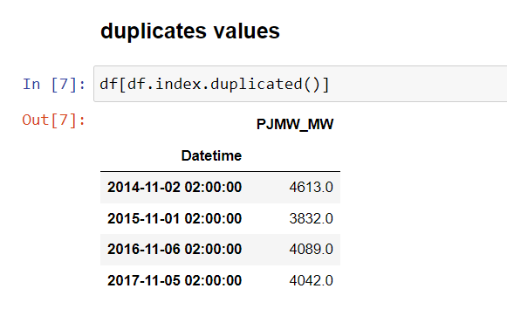
EXPLORATORY DATA ANALYSIS
Insights of the dataset:
143206 rows & 1 columns.
4 duplicates values found.
30 Missing values.
No outliers detected

Slide 5
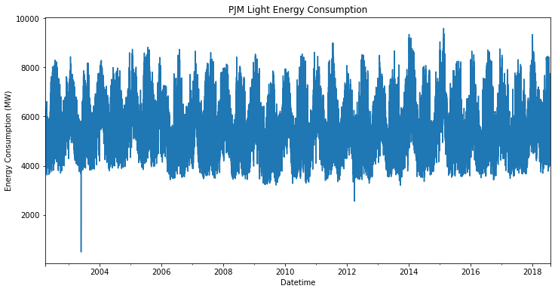
Data understanding
With this volume of data, we can’t see much with the exception of some possible fluctuation linked to seasonality throughout the year. Let’s take a look at annual average consumption.

Slide 6
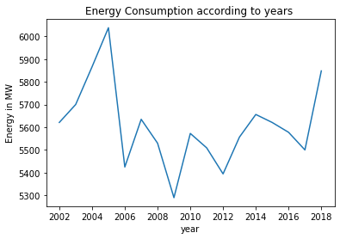
Data understanding
From the above figure we can see that high amount of energy consumed in the year 2002-2006 and 2018 compared to the other years.

Slide 7
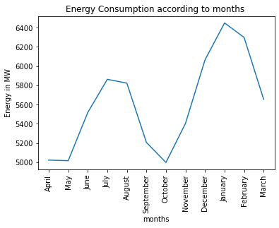
Data understanding
For summer and winter months typically have higher energy demand while spring and fall are lower. This matches intuition that months with more extreme temperatures have more energy consumption (likely due to increased use of air conditioners/fans and heaters).

Slide 8
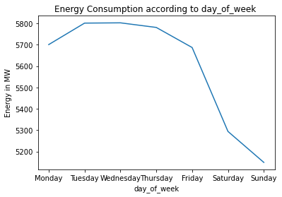
Data understanding
Energy consumption on Saturday and Sunday are lower. This reflects the intuition that energy use is typically lower on the weekends.

Slide 9
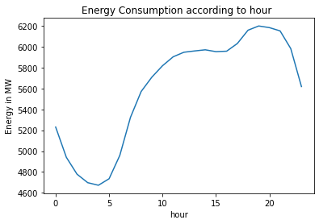
Data understanding
Here we can see the daily trend of energy consumption decreasing from 8pm to 5am. This reflects intuition that energy demand is lower at night when consumers are typically asleep. We also see an upward trend between 5am to 7pm. This reflects intuition that energy demand increases as consumers begin their day and evening.

Slide 10
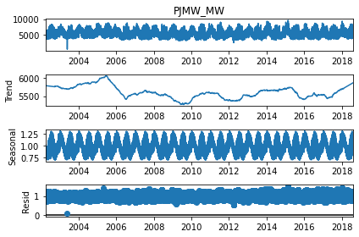
ETS Decomposition
We can see that, there is no trend. However, there is seasonality.

Slide 11
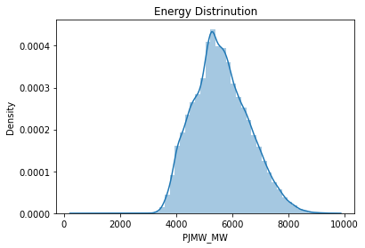
Energy Distribution
Due to constant trend, we see the normal distribution.

Slide 12
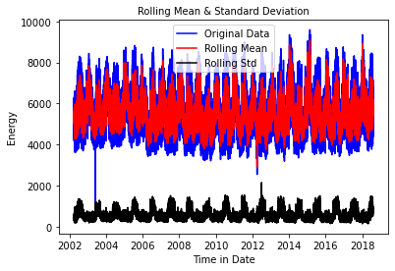
Stationarity Check
Test stationary using Augmented Dickey Fuller’s Test.
Stationary data is data whose statistical properties like mean, variance, covariance do not vary with time or these statistical properties are not the function of time. a stationary data series has without a Trend or Seasonal components.
Stationary series is easier for statistical models to predict effectively and precisely.
Test Statistic -19.935246
p-value 0.000000
#Lags Used 74.000000
Number of Observations Used 143157.000000
Critical Value (1%) -3.430396
Critical Value (5%) -2.861560
Critical Value (10%) -2.566781
dtype: float64
Failed to reject null hypothesis. Data is stationary
Here we got P-value as 0 because there is no trend in our data.

Slide 13
Resampling of data
Our data set have very large number of data points so we have down sampling our data for reducing the no. of data point.
By applying resample method the hourly data converted into daily data by which no. of data points decreases into 143232 to 5969.
Test Statistic -7.265243483352551,
p-value 1.6415165880027295e-10,
#Lags Used 33,
Number of Observations Used 5935,
{Critical Value '1%': -3.43145229664056,
Critical Value '5%': -2.8620271128107553,
Critical Value '10%': -2.56702928783387},
84235.17424544465)

Slide 14
Plot the ACF and PACF charts
Autocorrelation Function (ACF): It is a measure of the correlation between the time series with a lagged version of itself.
Partial Autocorrelation Function (PACF): This measures the correlation between the time series with a lagged version of itself but after eliminating the variations already explained by the intervening comparisons.
In the next step we will be determining the tuning parameters (p and q) of the model by looking at the autocorrelation and partial autocorrelation plots. The plot below provides a brief guide on how to read the autocorrelation and partial autocorrelation graphs in order to select the parameters.

Slide 15
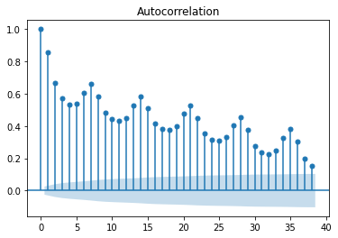
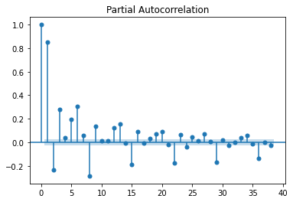
ACF and PACF for PJMW_MW
The above figure shows ACF and PACF relation for the resampled data without any differentiation.
we didn’t get any considerable value of p and q here.

Slide 16
Eliminating Trend & seasonality : Differencing
Differencing : One of the most common methods of dealing with both trend and seasonality is differencing. In this technique, we take the difference of the observation at a particular instant with that at the previous instant. the dataset is a non stationary series.

Slide 17
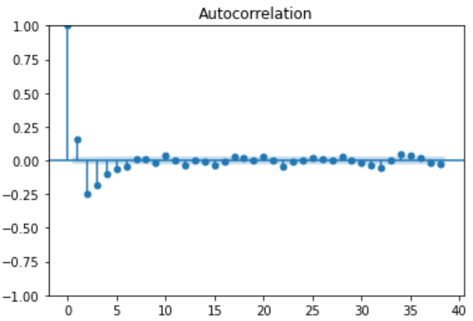
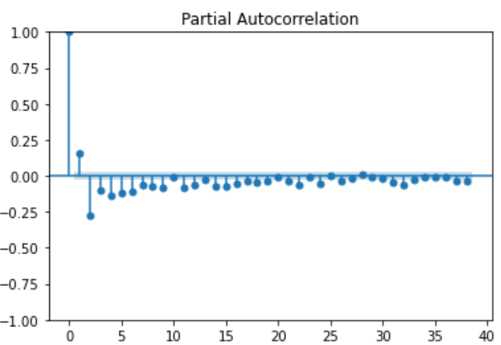
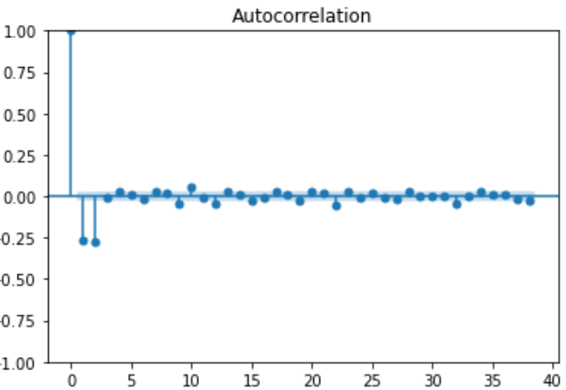
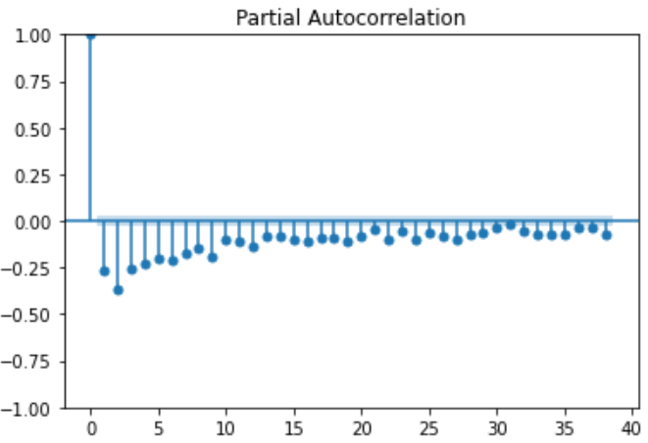
The above figures shows the acf and pacf for 1st order seasonal differentiation of seasonal period
We did not get any considerable P and Q value again.
Then we proceed for one more simple differentiation
The above figures shows the acf and pacf after one seasonal and one simple differentiation and got conservable “q” value which is equals to 2
Again not got any considerable PACF value because the spikes are seems like exponentially decreasing .
Then Finalised value of “q” as 2 and then proceed for model building.

Slide 18
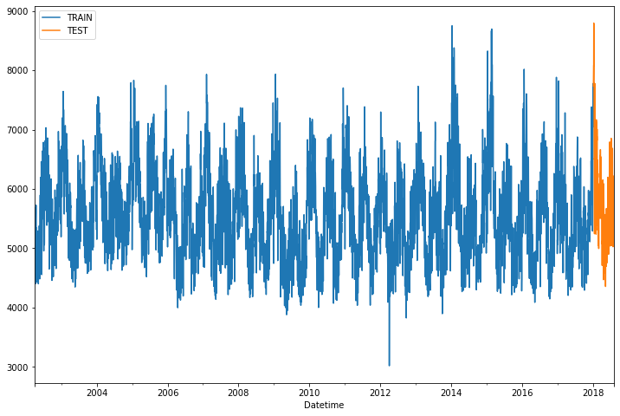
Splitting the data set into train and test
80% of our data set are taken for training and 20% of data taken for testing purpose
Train 5754 rows And 1 column
Test 215 rows and 1 column

Slide 19
MODEL BUILDING

Slide 20
Model Building
Model building done both on Stationary and non-stationary data set
Models used:
Simple Exponential smoothing
Double Exponential smoothing or Holt’s method
Triple Exponential smoothing or Holt’s –Winter method
ARIMA(Auto Regressive Integrated Moving Average)
SARIMA(seasonal arima )
Linear regression model

Slide 21
Model Building on Stationary data
Now building model on stationary after transforming the original data to stationary data.

Slide 22
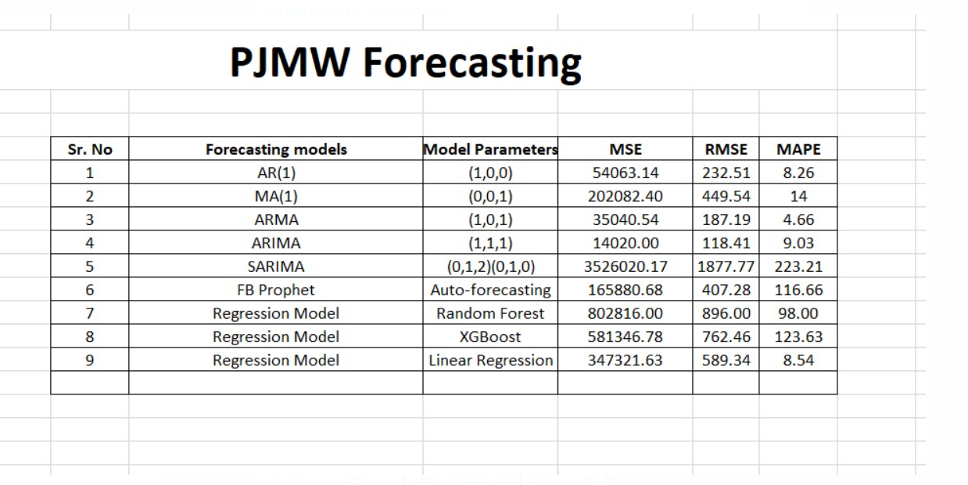
We finalised linear regression model for forecasting and deployment as it is giving considerable accuracy and convenient for deployment.

Slide 23
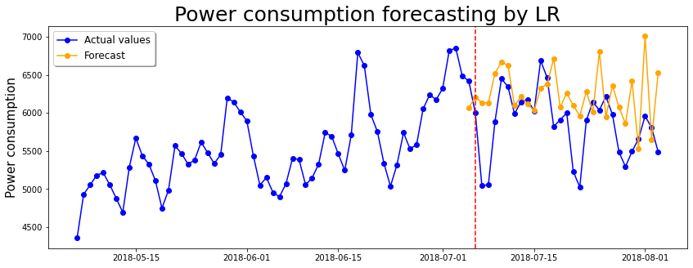
calculating forecasting accuracy
Linear Regression Model
Date range '2018-07-05','2018-08-03'

Slide 24
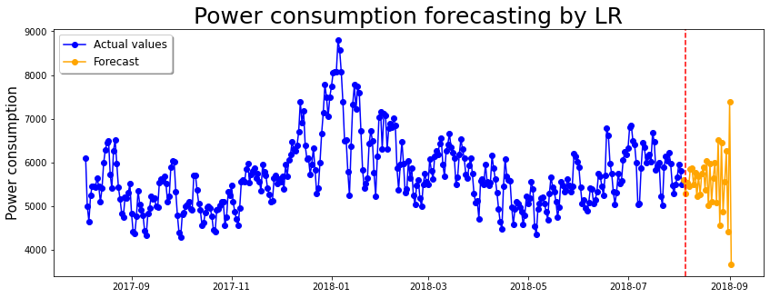
Forecast for future using linear regression model
Date range '2018-08-04','2018-09-02

Slide 25
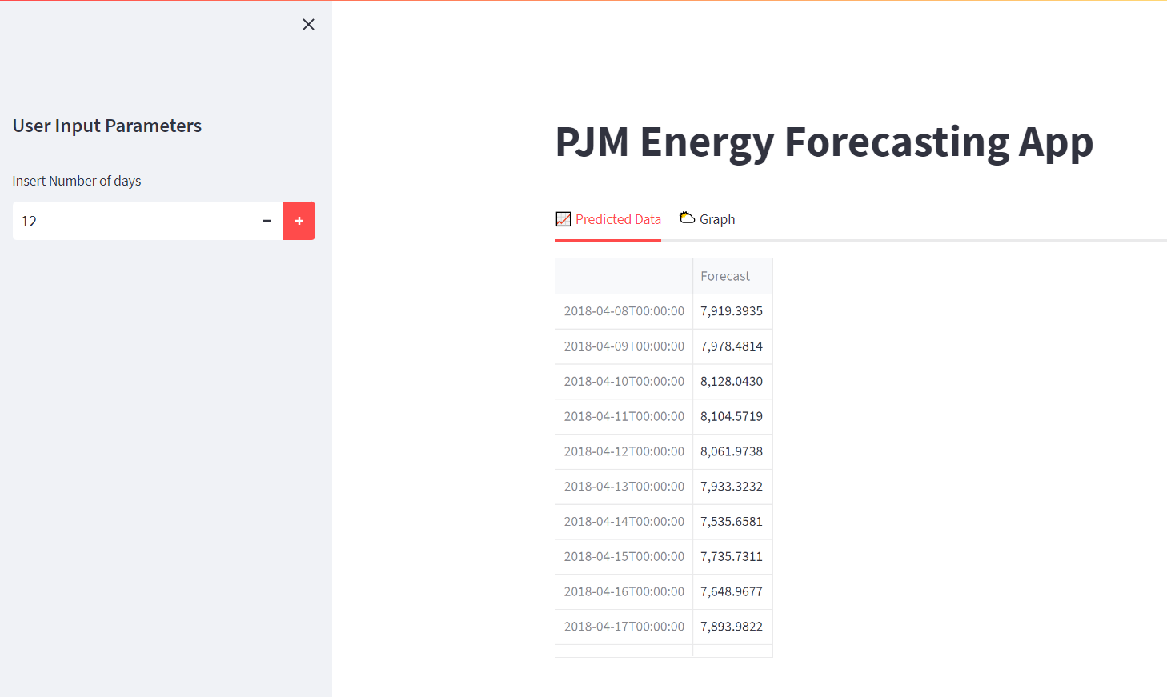
DEPLOYMENT-
The above image is from our deployed app page

Slide 26
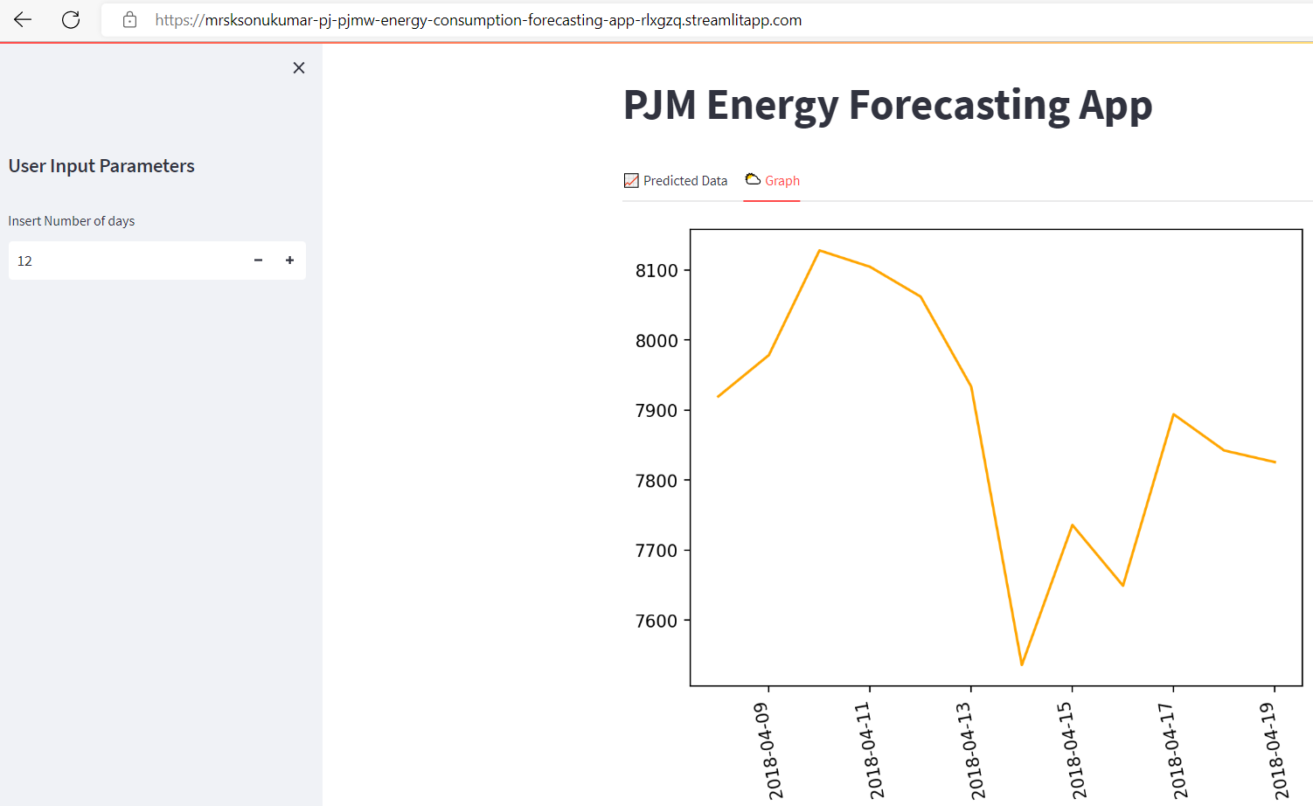
DEPLOYMENT-
Deployed app link -Streamlit (streamlitapp.com)

Slide 27
THANK YOU

